Slide 1
Approach to
Investigate a Performance Problem
Date: July 18, 2016

Slide 2
Typical questions regarding performance issues raised in Production:
Business users reported a particular page of SunnyCare application is slow, are we able to
  Confirm the symptom is not because of their desktop resource problem but a real application related issue?
  Tell us quickly which components of application should we start off the investigation from? (Browser, IIS, ColdFusion, Node.js, Radios, Sybase database and etc.)
  Break down in terms of time spent in each application component so that we know what our end user experience of SunnyCare looks like
We know the problematic performance scenarios but there are limited options to allow us to troubleshoot it in Production, are we able to
  Replicate performance scenarios in another test environment (assuming the same piece of application code running in different environments) ?
  Utilize existing monitoring tools to enable slow or problematic transactions monitoring, tracing & analysis in isolations mode

Slide 3
We are able to answer above questions, as long as we can
Isolate the performance problem
Replicate the problem in a contained environment
Leverage the available tools to provide accurate measurement of true end-user time
Leverage available techniques and tools to enable slow or problematic transactions monitoring, tracing & analysis in isolations mode
…
In next few slides, we will be using a real scenario to demonstrate how to investigate a performance problem as well as providing answers to those questions raised in previous page

Slide 4
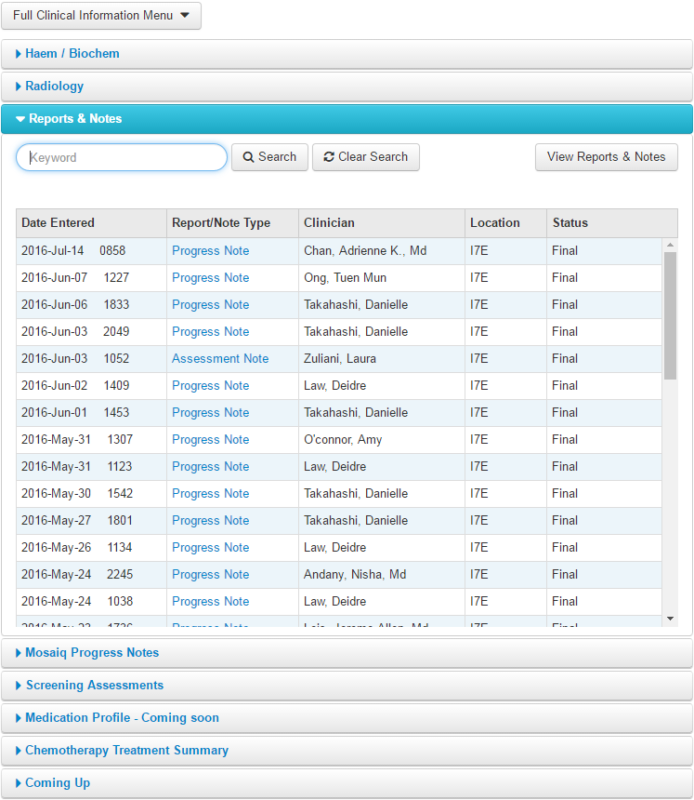
Use case walkthrough
Scenario:
“Business users reported that Searching in ‘Reports & Notes’ page is very slow e.g. over 10 seconds”

Slide 5
Approach:
Validate the scenario
Rule out the noise
Replicate the scenario
Correlate the information

Slide 6
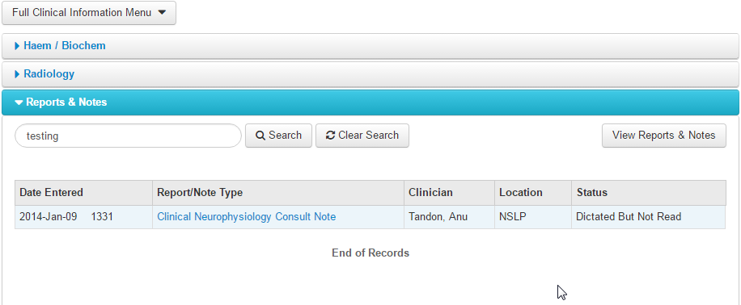
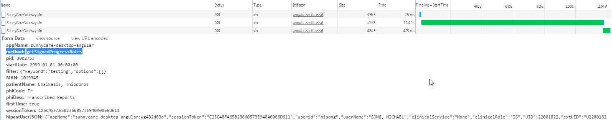
Step 1) Validate the scenario reported by the Business users:
Chrome developer tool:
Performed a simple search on “Reports & Notes” took 11.42 seconds in
Main method involved was “getSignedProgressNotes”

Slide 7
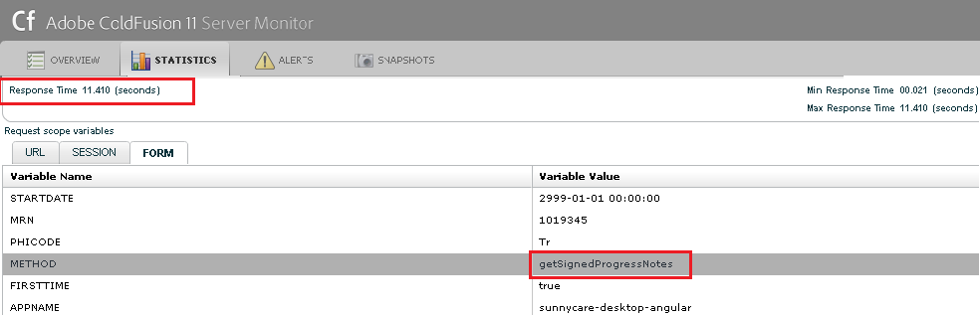
Step 2) Rule out the noise:
When the Business users reported a slowness in application or occurs in a particular page of application, sometimes it might cause by the application clients (not application itself) for various reasons such as: other desktop applications consuming high resource to impact the browser performance, browser differences (e.g. JavaScript engine), browser version differences and etc.
There are many ways to rule out the client performance to allow us to focus on a true server-side’s performance issue:
- Analyzing specific method call server logs or monitoring method calls in Console (turn on monitoring for a short duration if
possible)
ColdFusion Console: (snippet)
In console admin page, “getSignedProgressNotes” was listed in “Slowest Requests section” : took 11.410 seconds
Coldfusion-out.log: (snippet)
Jul 19, 2016 09:57:53 AM Warning [ajp-bio-8013-exec-21] - Thread: ajp-bio-8013-exec-21, processing template: E:\WebApps\SunnyCareRelease\sunnycareservices\SunnyCareGateway.cfm, completed in 11 seconds, exceeding the 10 second warning limit
Jul 19, 2016 09:57:53 AM Information [ajp-bio-8013-exec-21] - Route --> getSignedProgressNotes

Slide 8
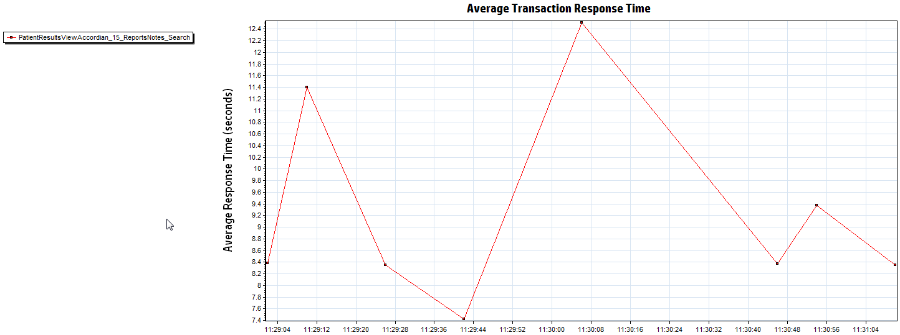
Step 3) Replicate the scenario
Unlike other performance testing tools, HP Loadrunner allows us to measure true end user time: HTTP time + browser execution time
Table below showed the results using HP Loadrunner simulating 8 searches within ~ 2 minutes in Release environment
Note:
  We will use 2nd search as an sample in next slide: it took 11.4 seconds @ time stamp 16- Jun-2016 11:29
  HP Loadrunner transaction was named as ‘PatientResultsViewAccordian_15_ReportsNotes_Search’ and this name
  was included in the header of web request initiated from HP Loadrunner
Transaction Sequence # | 1 | 2 | 3 | 4 | 5 | 6 | 7 | 8
Response Time | 8.4 | 11.4 | 8.3 | 7.4 | 12.5 | 8.3 | 9.2 | 8.1
12.5
11.4
9.2
8.4
8.3
8.3
8.1
7.4

Slide 9
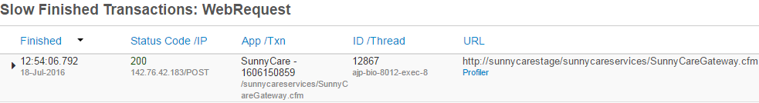
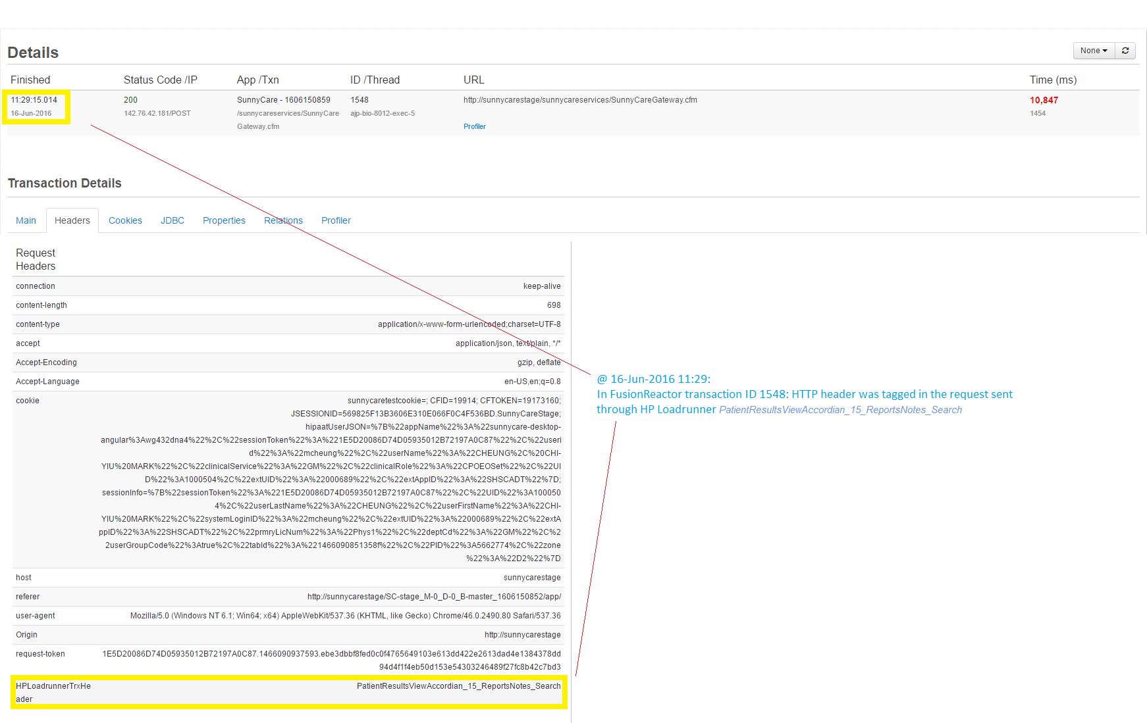
Step 4) Correlation:
    Almost all of the SunnyCare web API requests are formed against http://sunnycarestage/sunnycareservices/SunnyCareGateway.cfm. (example is listed below) Is there anyway to quickly differentiate them based on their APIs named method calls? How can we link the APIs call and HP Loadrunner to enable end-to-end transaction tracing?
The simplest way to get HP LoadRunner transactions in FusionReactor is ‘painting’ the HP LoadRunner requests. This method involves adding a custom header that contains the LR transaction name in the request so that FusionReactor can display the transactions exactly as they appear in HP LoadRunner.
  The request that occurred @11:29 (traced in ColdFusion server) for ‘Search Reports & Notes’ was tagged in the header ‘PatientResultsViewAccordian_15_ReportsNotes_Search’.
  It showed the server time including database calls took 10.847 seconds
HP Loadrunner (End user response time) | ColdFusion + Database backend (Application Server + backend time) | Front end + network (Client time e.g. html, image, and Javascript)
11.4 | 10.847 | 0.553

Slide 10
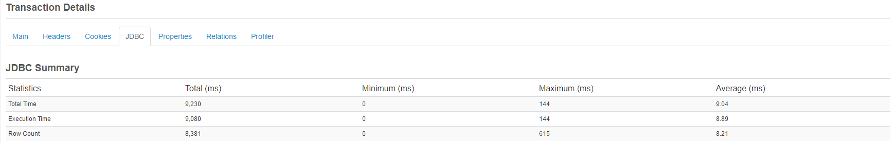
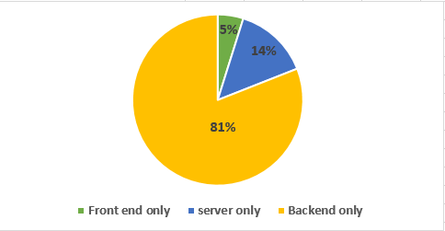
Step 4) Correlation continue:
Where is it slow for Search on ‘Reports & Notes’ ?
- Below ‘Transaction Details’ table showed JDBC time including SQL query execution time took 9.230 seconds.
Overall Response time breakdown for Search on ‘Reports & Notes’:
HP Loadrunner (End user response time) | ColdFusion + Database backend (Application Server + backend time) | JDBC time (Connection pool + Database time) | Front end only (Client time e.g. html, image, and Javascript) + network latency | ColdFusion server only
11.4 | 10.847 | 9.230 | 0.553 [ = 11.4-10.847 ] | 1.617 [ = 10.847-9.230 ]

Slide 11
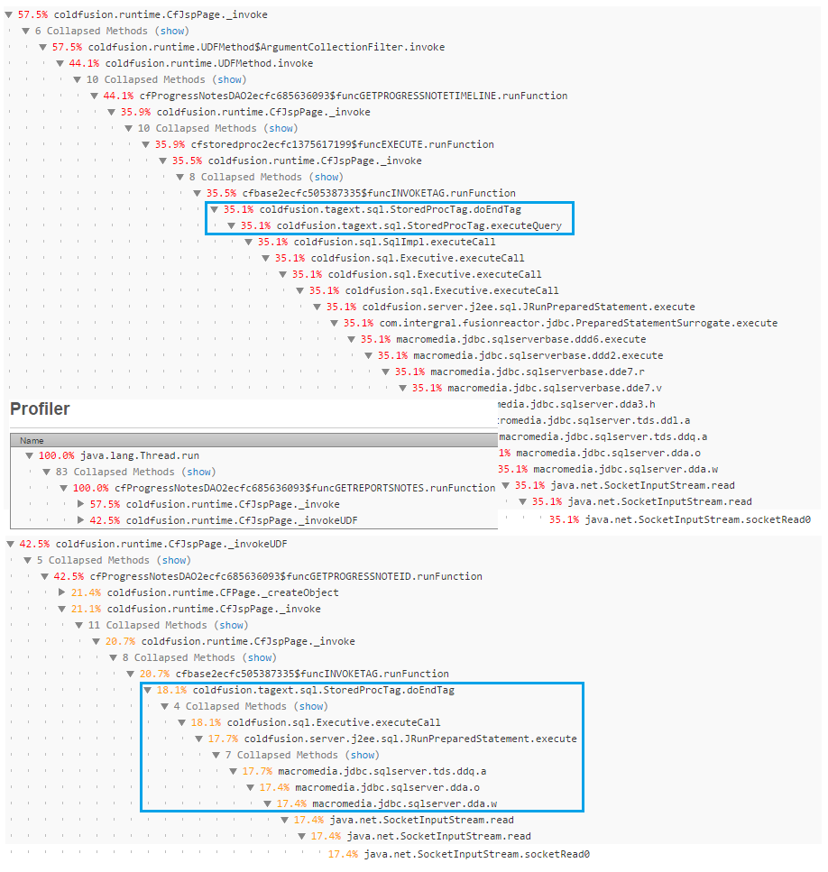
Step 4) Correlation continue:
Further profiling for such transactions is needed in order to find out why 2 store procedures were slow
- “getReportNote” in ColdFusion code trigger 2 store procedure calls and consumed most of execution time : 35.1% &18.1% of total execution time

